Slide 1


eHospitality Pro : A Modern Online Hotel Management Solution
HOTEL MANAGEMENT SYSTEM
By:
22070122206 Shruti Bist
22070122216 Soumili Biswas
22070122219 Srishti Parulekar

Slide 2

IDEA
Problem Statement: Our Hotel Management System addresses the need for efficient room reservations, billing, and invoicing in a hotel setting. This system uses key object-oriented programming (OOPs) concepts in C++ to achieve these objectives.
Introduction: The provided C++ code is a comprehensive hotel management system designed to streamline the process of room bookings, billing, data management, and more. Here’s how users can interact with the system:
Room Booking: Users can book rooms based on their preferences. They can choose from different types of rooms such as Classic Room, Deluxe Room, and Suite Room. The system also allows users to specify the number of occupants for each room.
Billing: After a room is booked, the system calculates the total bill for the stay based on the type of room, number of occupants, and duration of stay. The bill is then presented to the user for payment.
Data Management: The system maintains a record of all rooms in the hotel along with their current status (vacant or occupied), details of occupants (if any), and billing information. This data is stored in a CSV file for easy access and management.
Room Deletion: Users can delete a room booking if they no longer need it. The system updates the room status to vacant and removes any occupant information associated with that room.
Room Search: Users can search for rooms based on various criteria such as room type, floor number, or occupancy status. This makes it easy for users to find a room that suits their needs.
User Interaction: Users interact with the system through a simple console-based interface. They are prompted to enter details such as the number of occupants, type of room, check-in and check-out dates, etc. The system then processes these inputs to book rooms, calculate bills, delete bookings or search for rooms.
Data Persistence: The system saves all room details to a CSV file every time a change is made. This ensures that all data is preserved even if the program is closed and reopened later.
This hotel management system simplifies many of the tasks involved in running a hotel, making it an invaluable tool for hotel owners and managers.

Slide 3


OOP : Object - Oriented Programming
Class
A blueprint for creating objects which encapsulates data and methods
Inheritance
A mechanism where one class acquires properties of another class
Friend Function
It is a non-member function that has the privilege to access private and protected data of a class
Object
An instance of a class representing a real-world entity
Operator Overloading
is a compile-time polymorphism technique that allows the same operator to have different meanings based on their operands
Polymorphism
The ability of an object to take on many forms, allowing for a single interface to represent different underlying forms
Encapsulation
The bundling of data and methods that operate on that data within one unit, restricting direct access to some of an object’s components
Destructor
It is a special method that is invoked automatically whenever an object is going to be destroyed, often used to clean up any resources allocated during the lifetime of the object.
Abstraction
Hiding complex details and showing only the essentials to reduce complexity and increase efficiency
Constructor
It is a special method that is automatically invoked at the time of object creation to initialize the data members of new objects
Composition
It is a design technique that implements a “has-a” relationship between objects, allowing you to model real-world relationships between different entities
Function Overloading
This is a feature in C++ where two or more functions can have the same name but different parameters, enhancing code readability and reusability

Slide 4

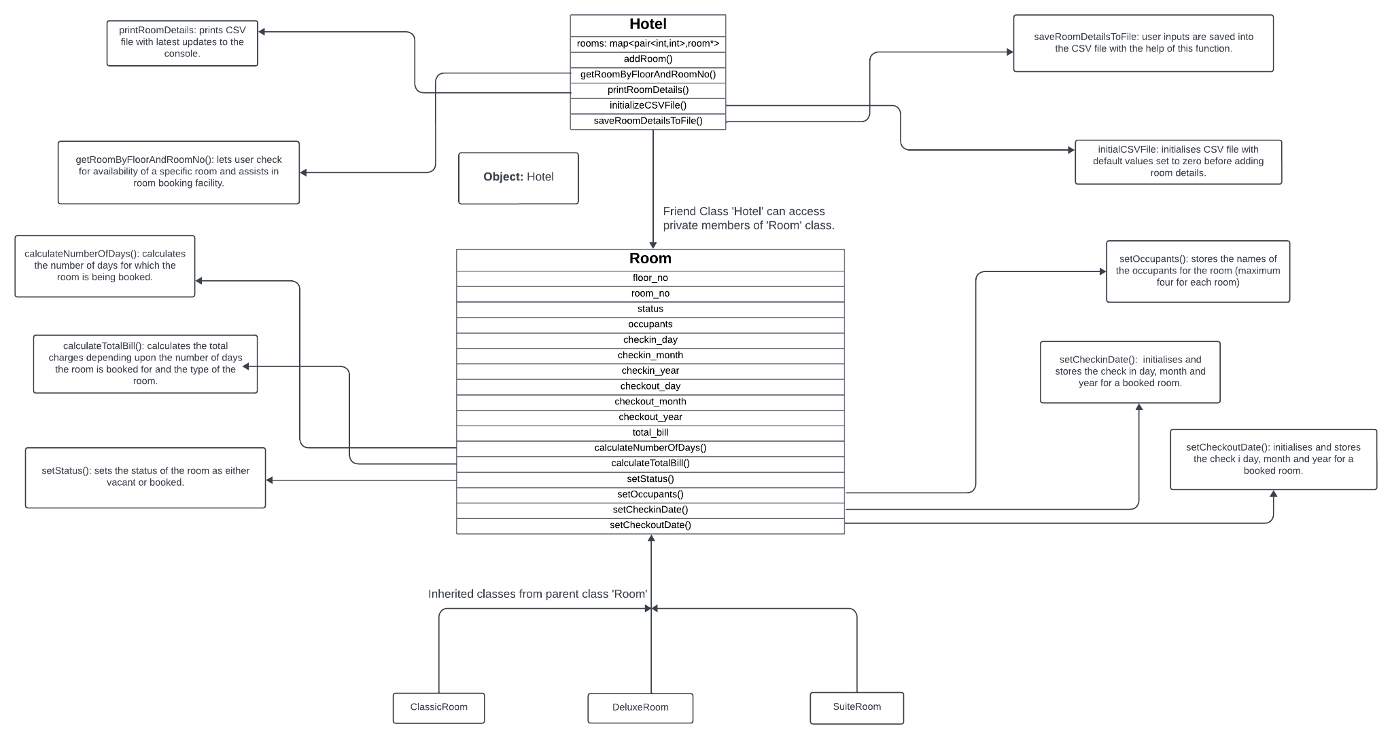
Class Diagram

Slide 5




Code and Output

Slide 6
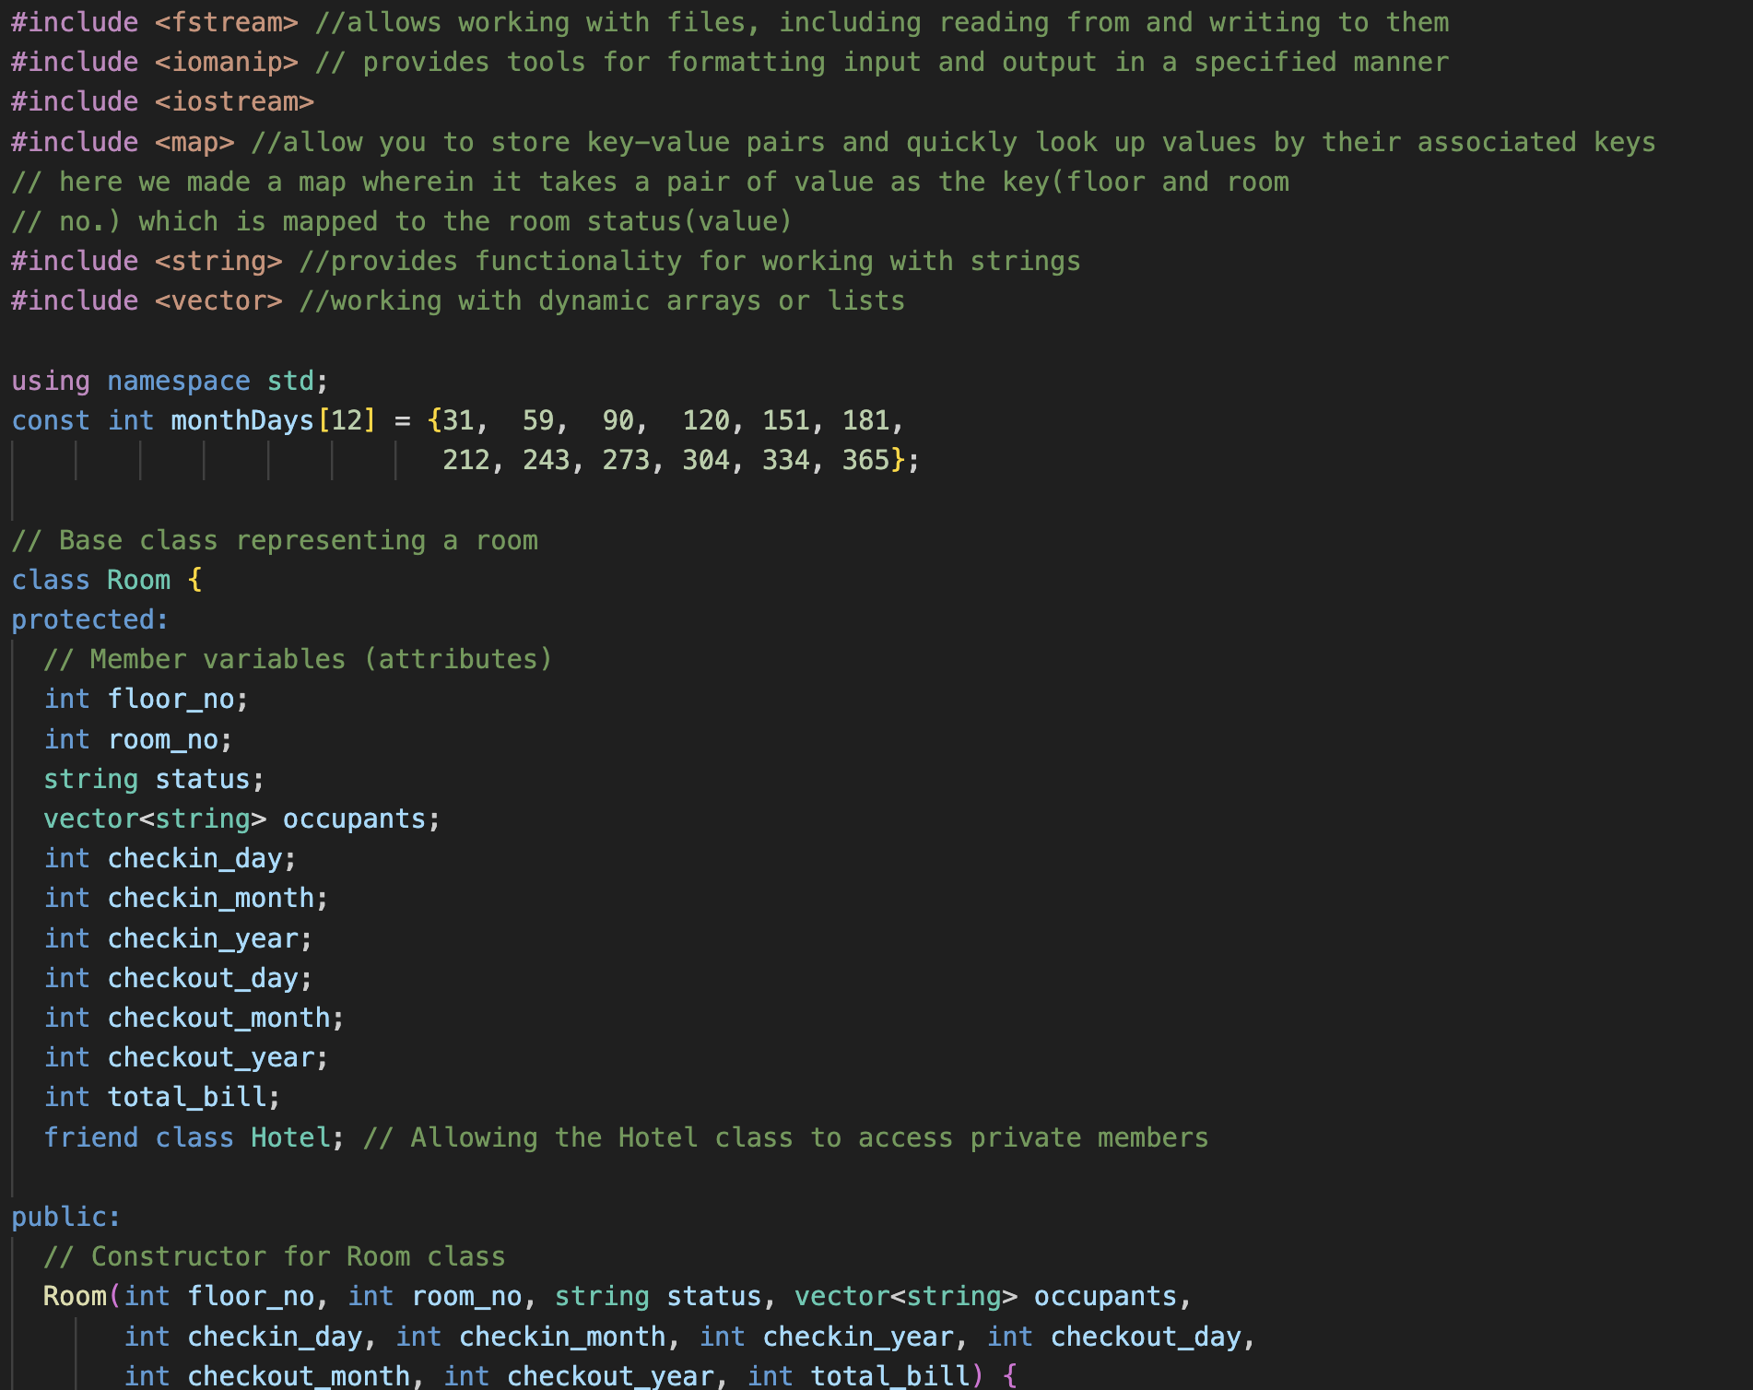
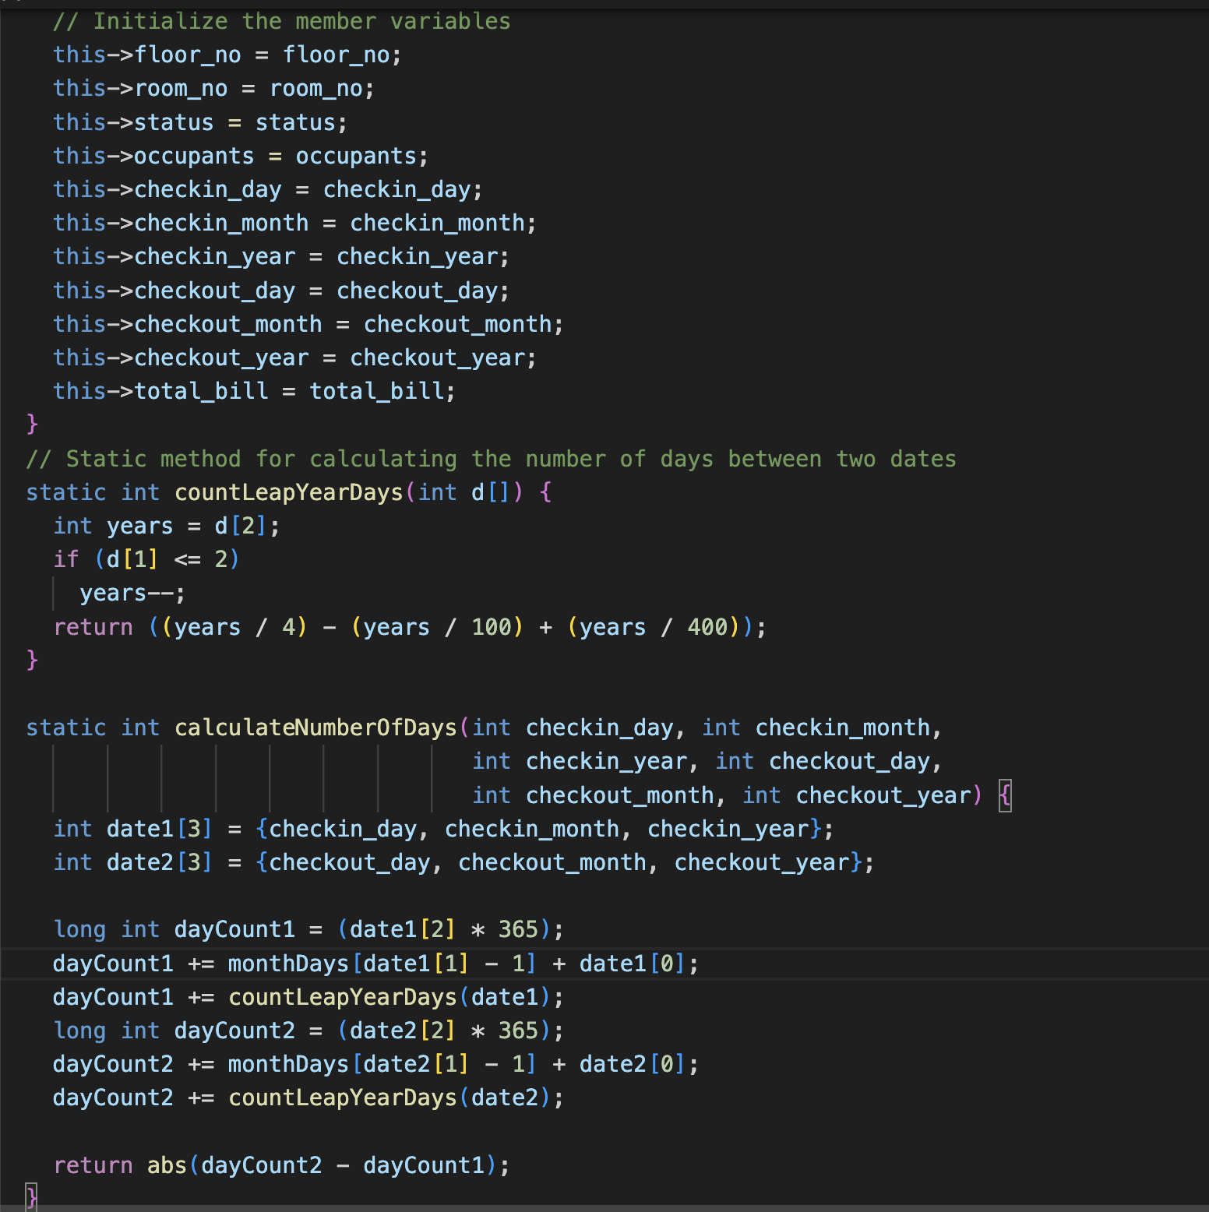



Slide 7
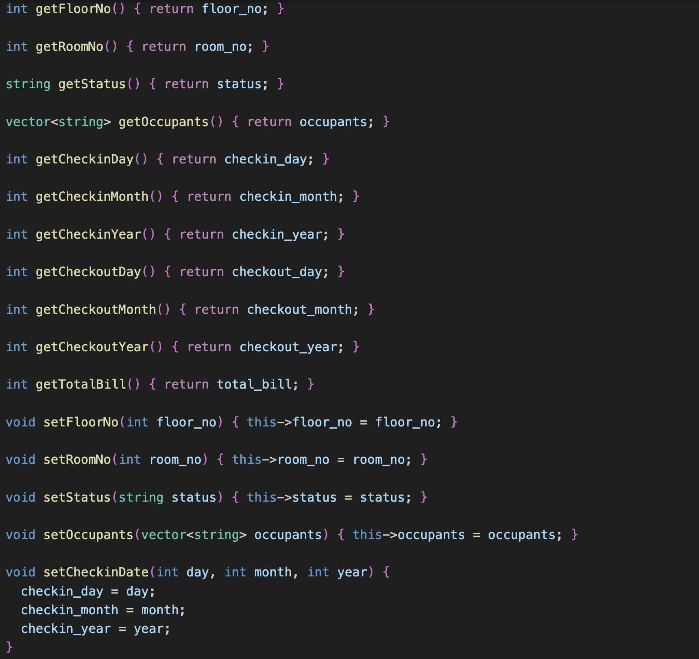
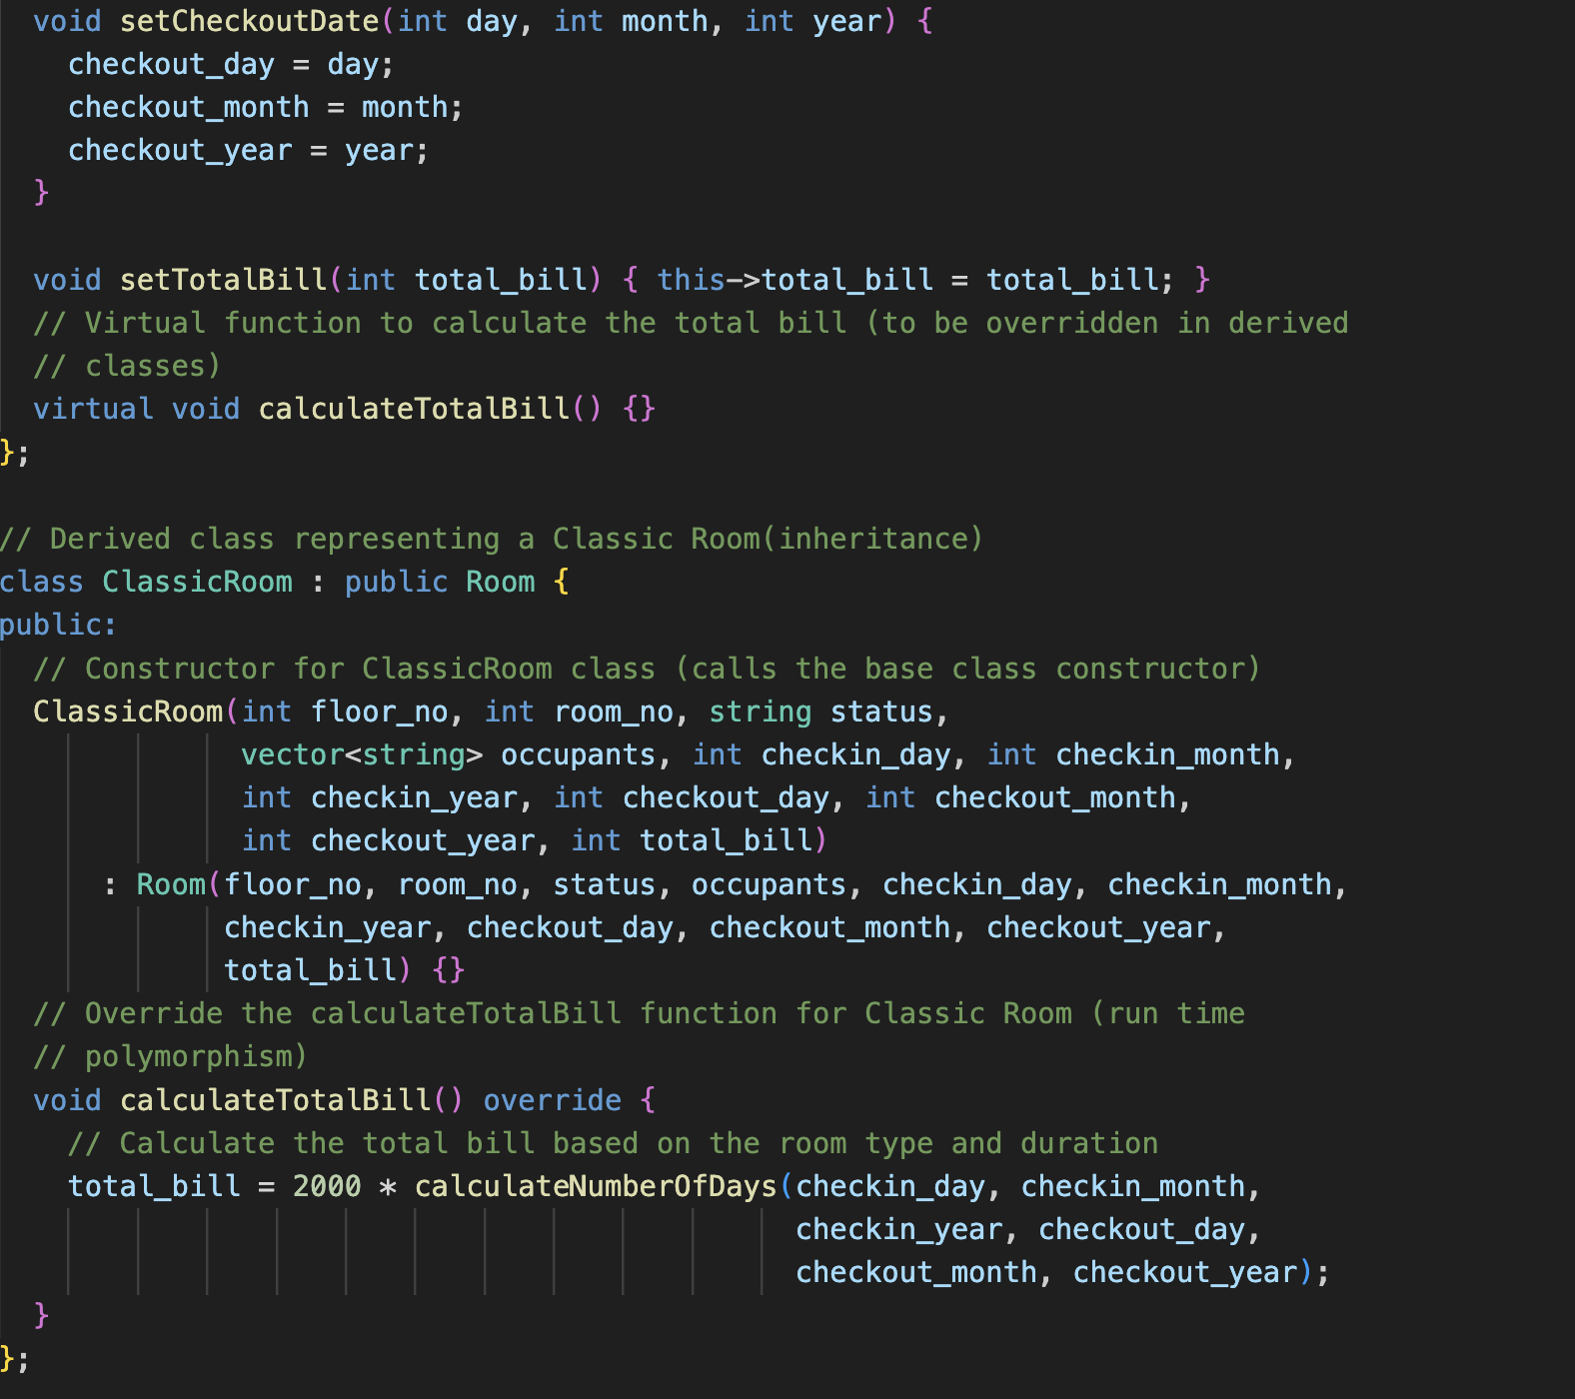


Slide 8


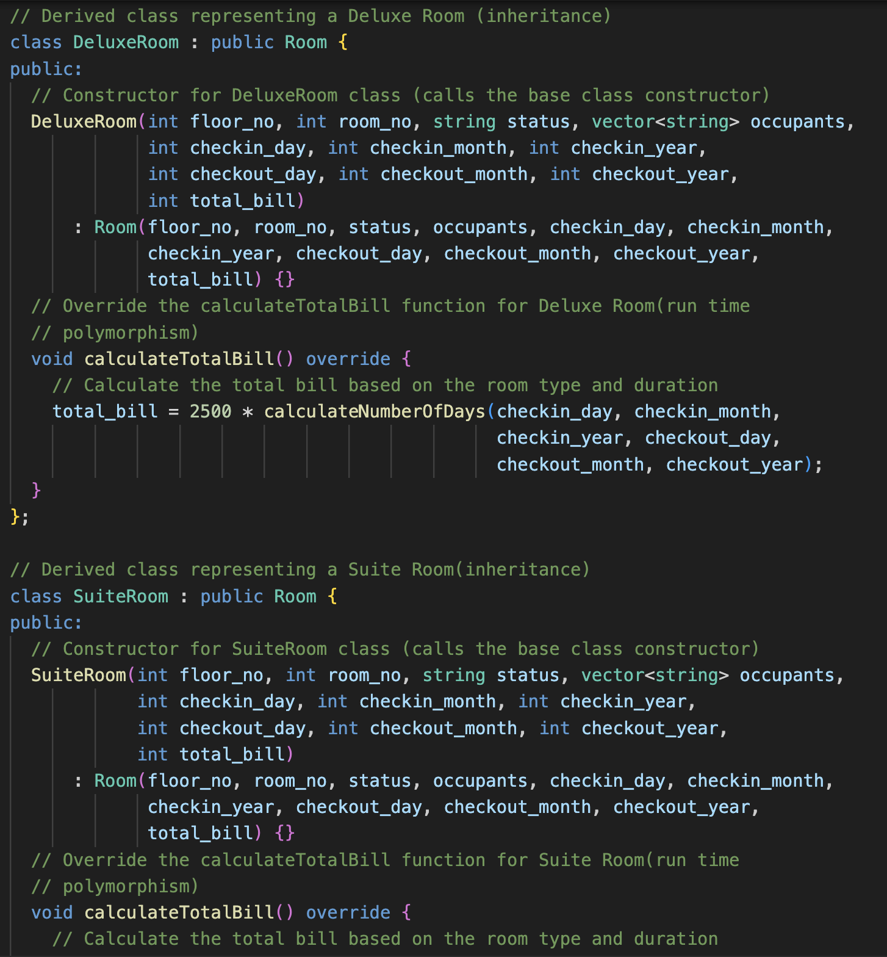
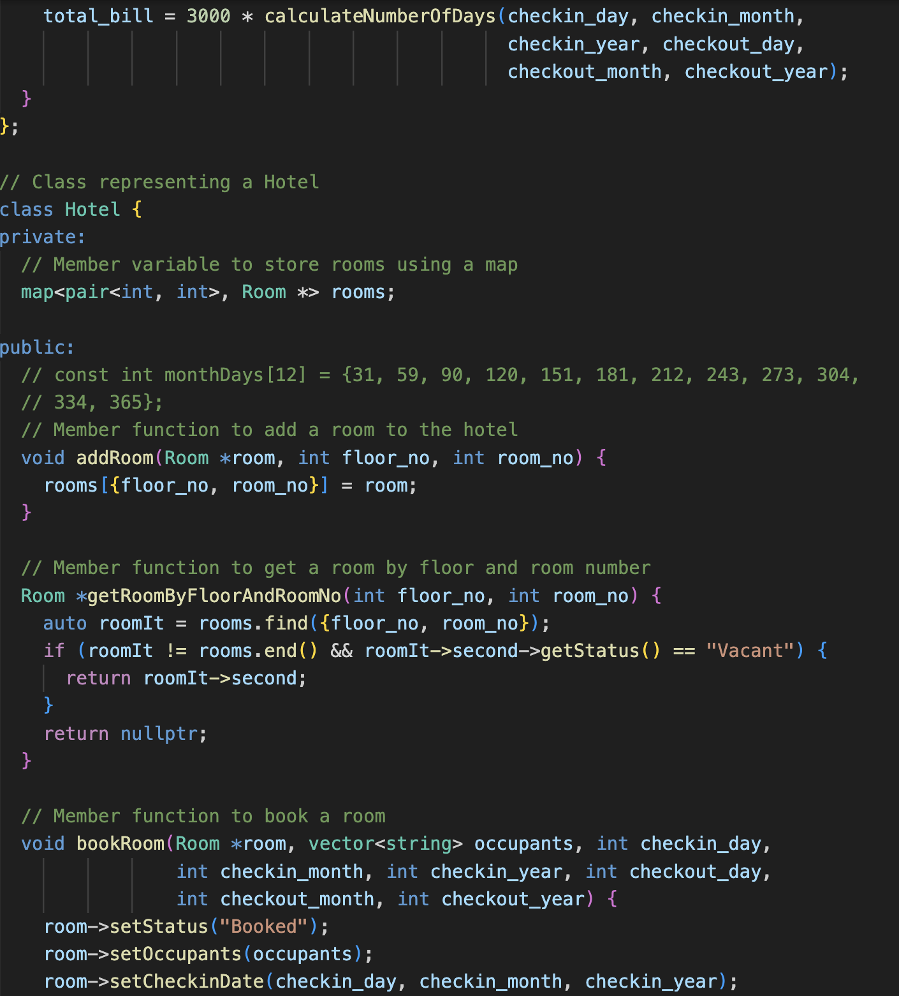

Slide 9
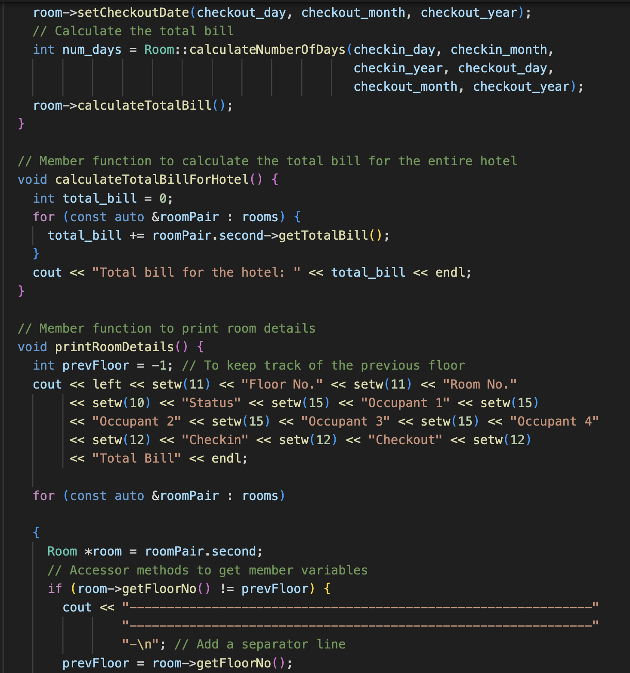
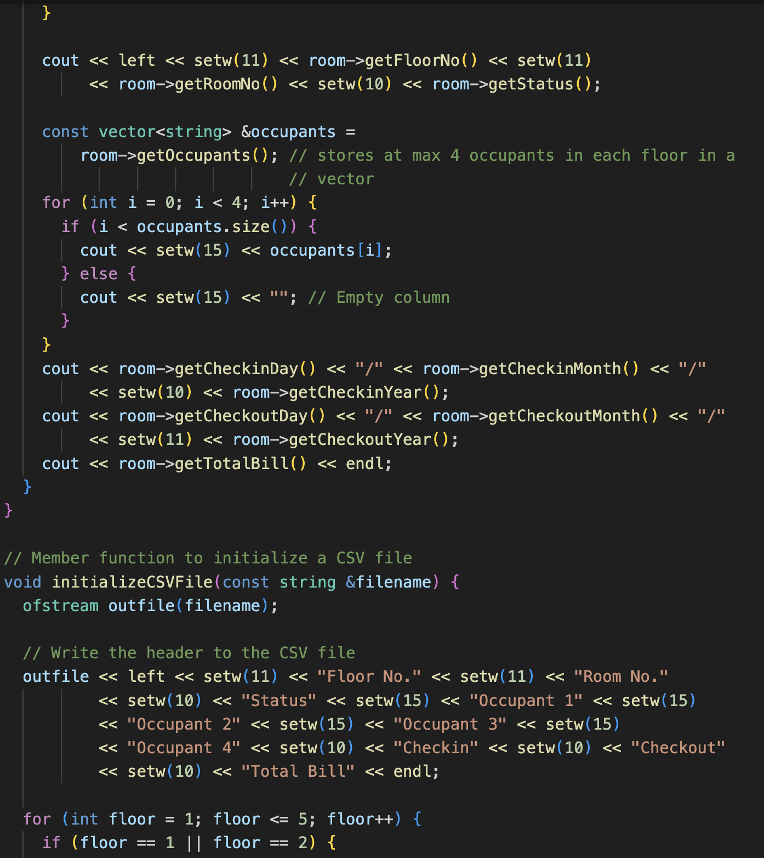

Slide 10
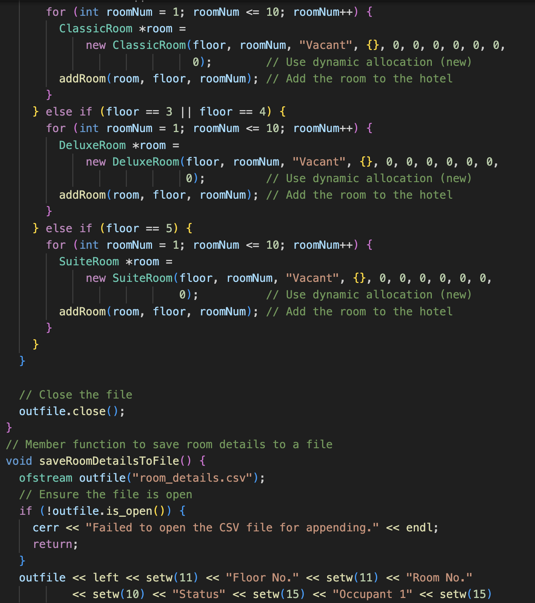
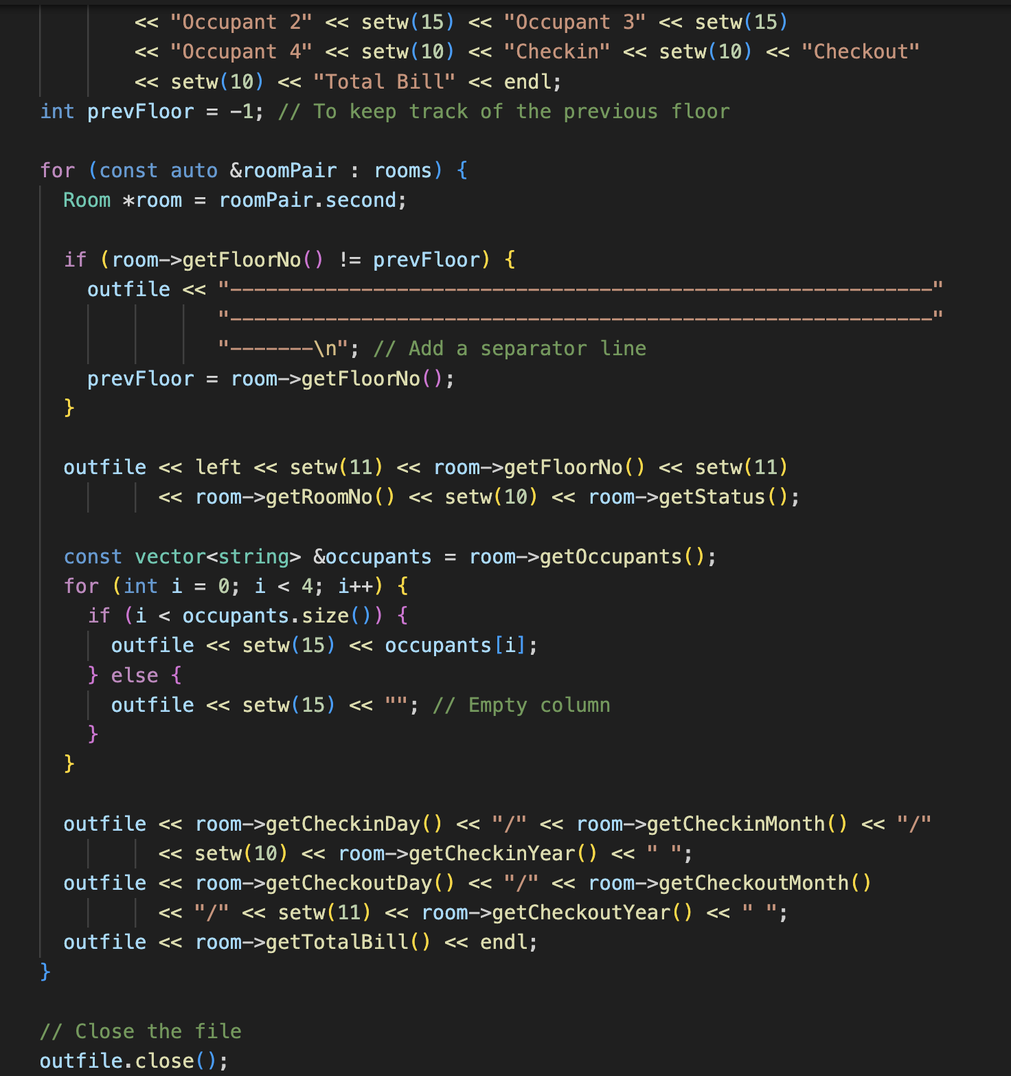

Slide 11
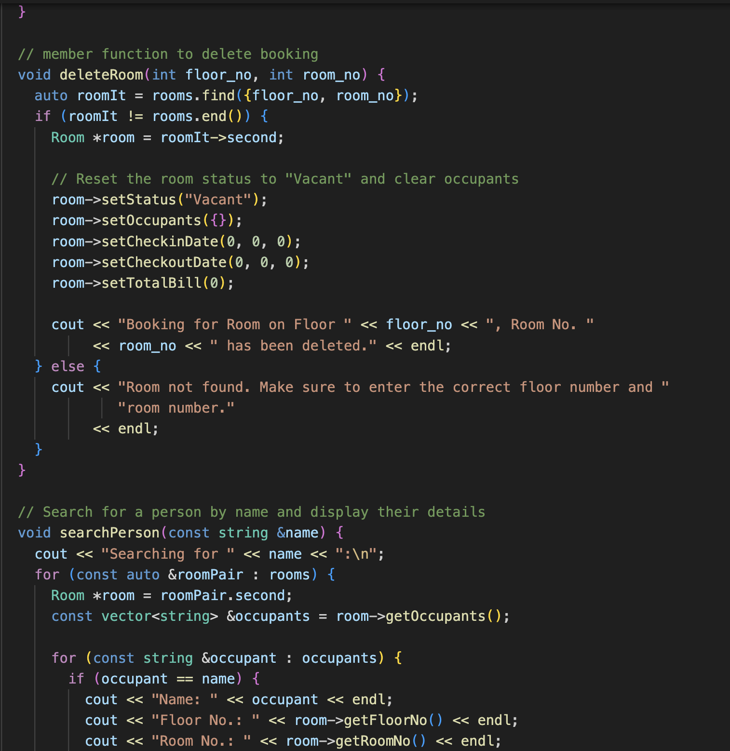
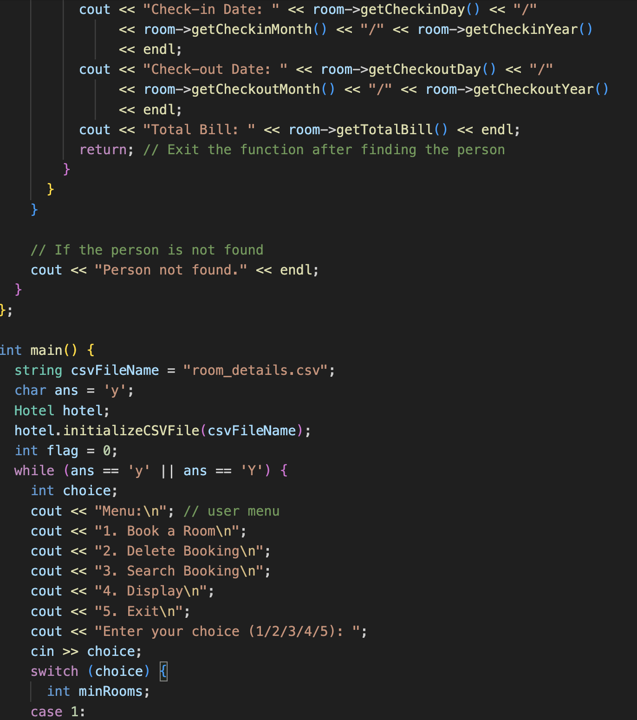



Slide 12

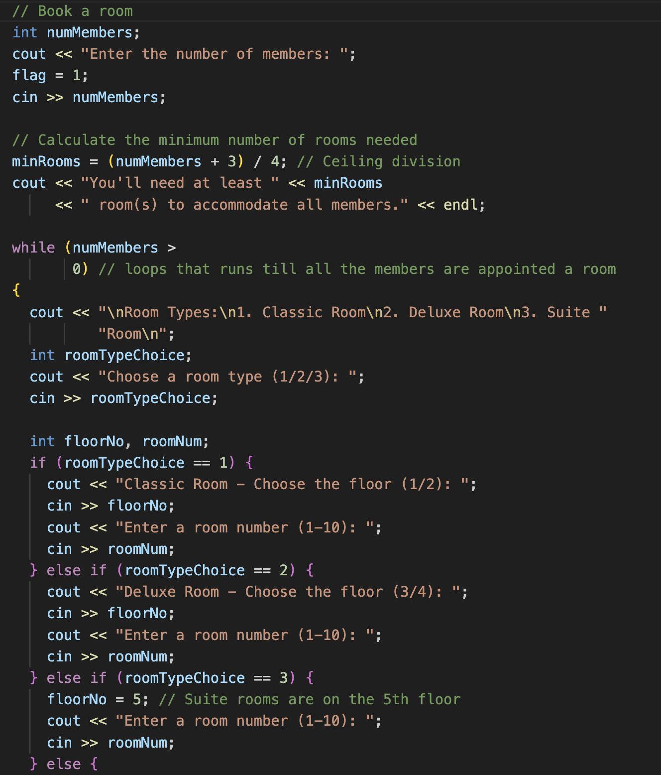

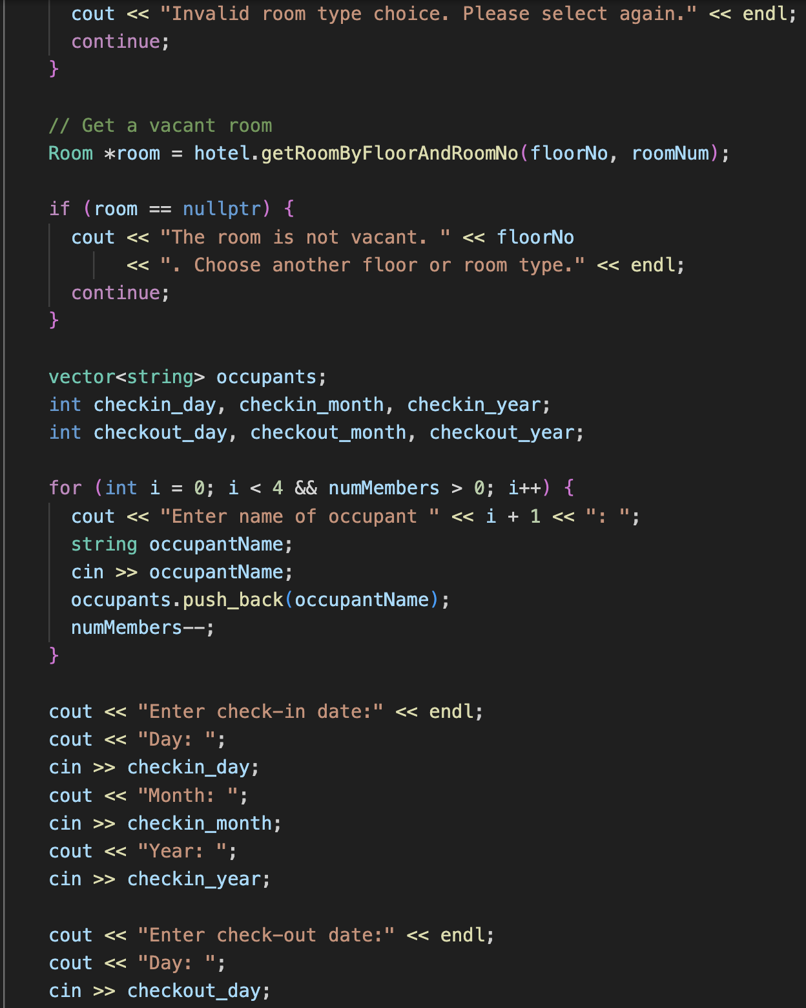

Slide 13

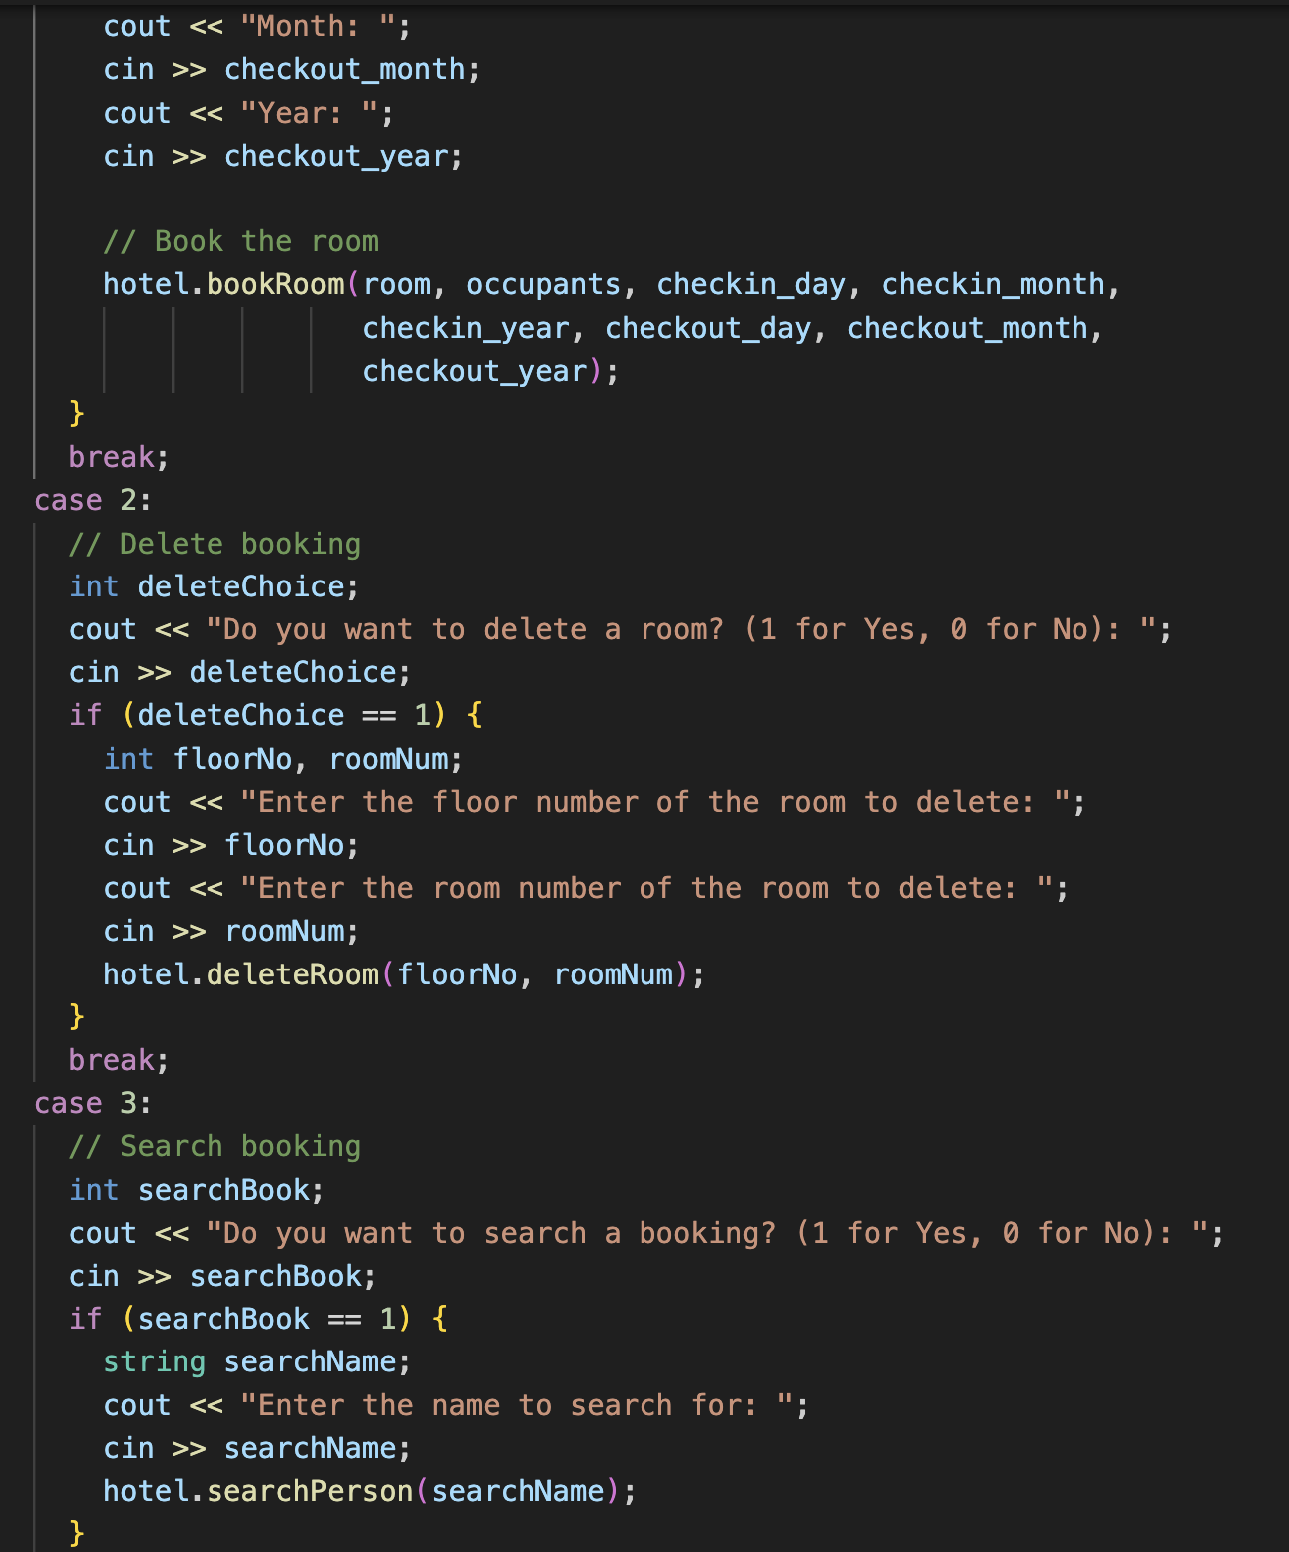
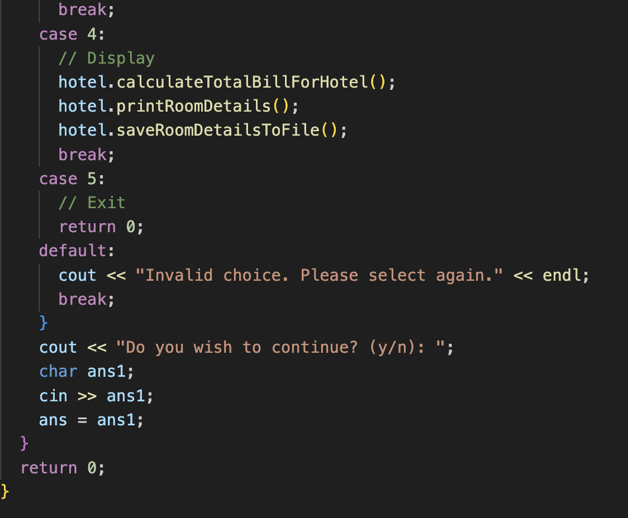

Slide 14
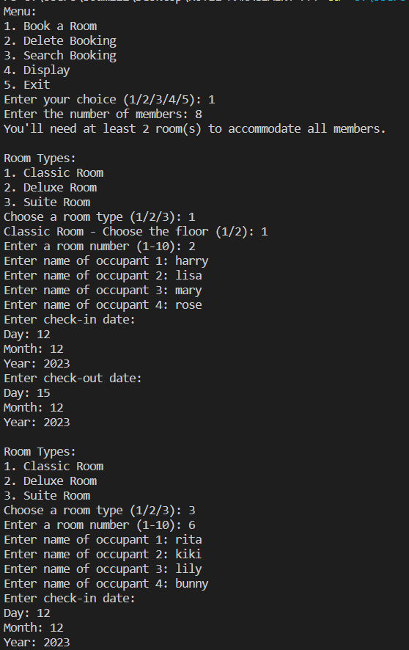
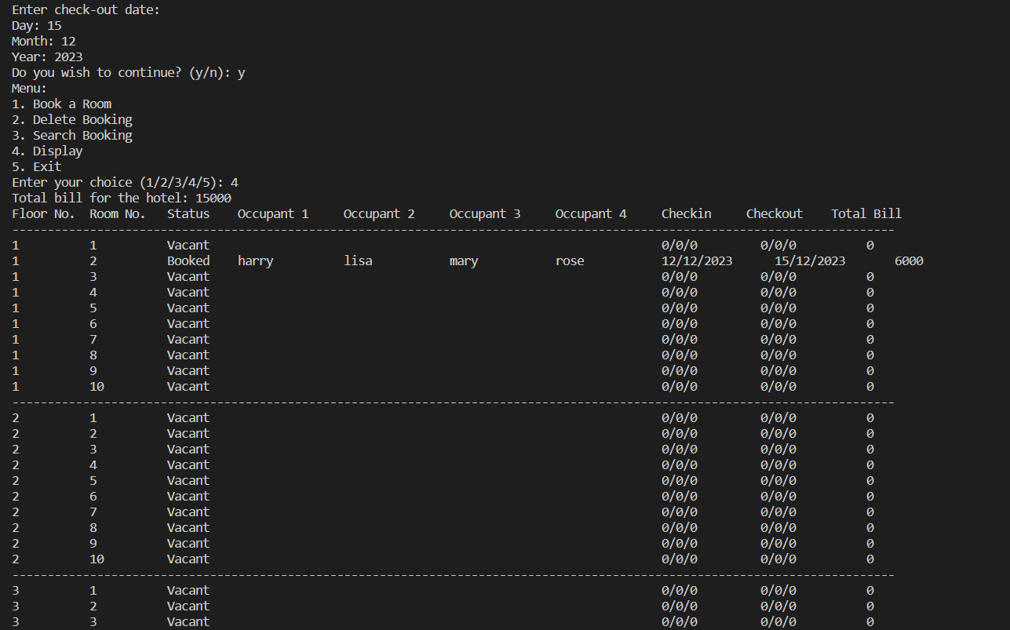

The menu is displayed initially and the user books a room for eight people. Therefore, a minimum of 2 rooms is needed.

Slide 15


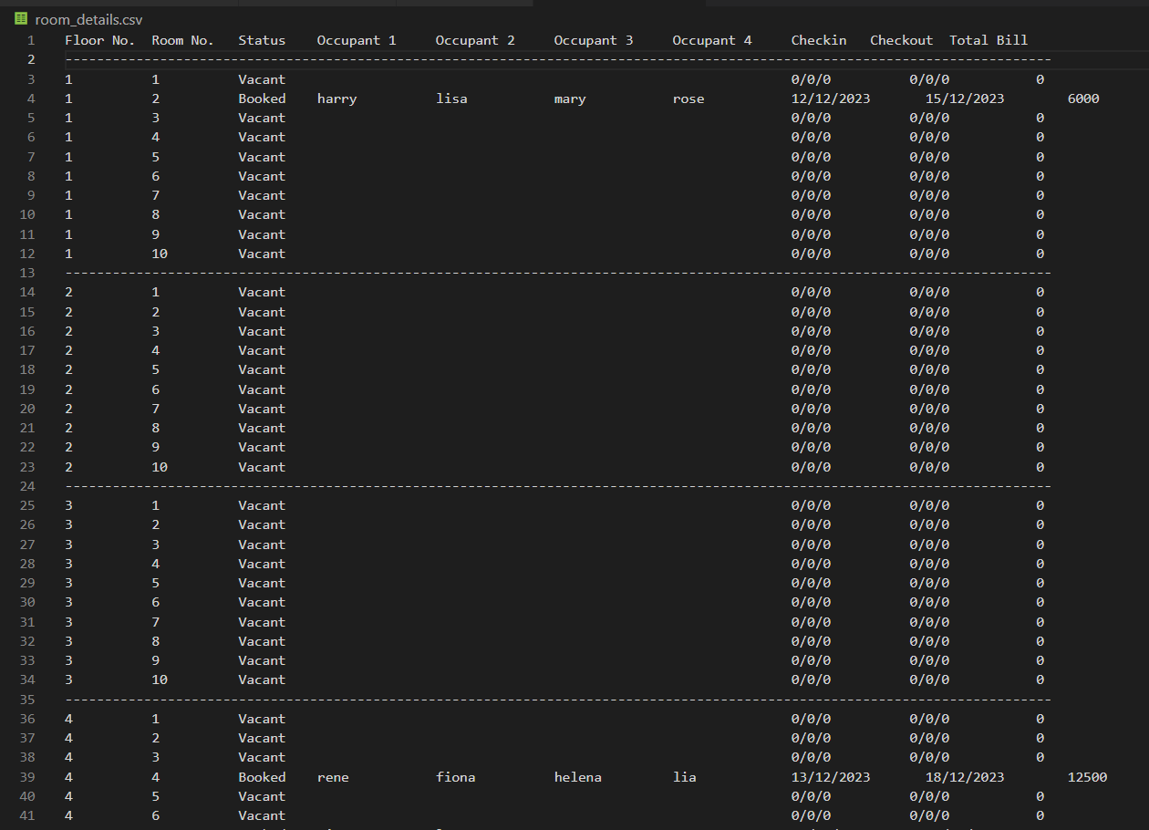
A database is created and an output is displayed in the CSV file.

Slide 16
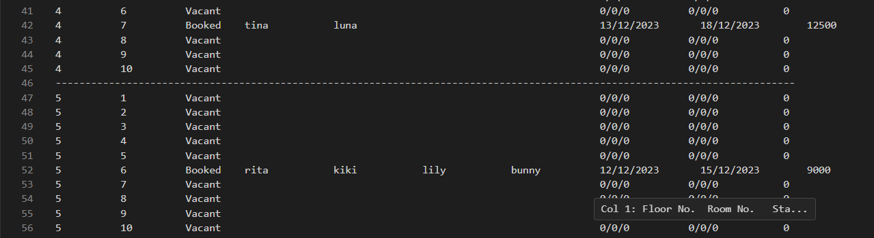
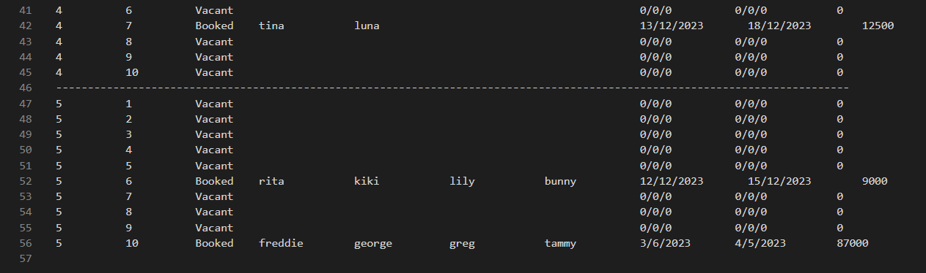

If the user wishes to delete a room booking ( here room number 10 on the fifth floor)

Slide 17

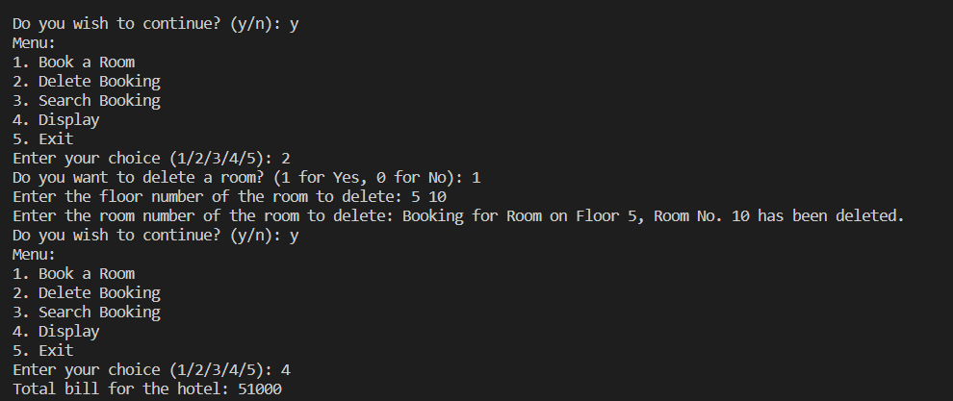
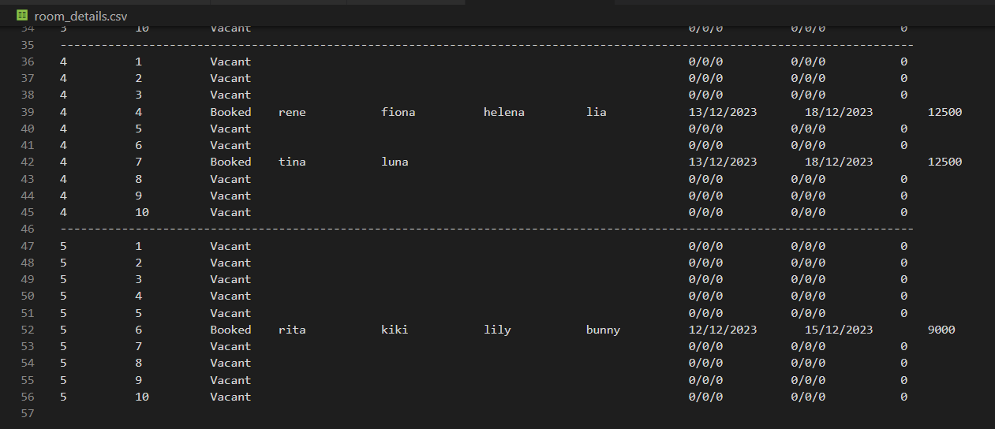
Thus, the 10th room on the 5th floor gets deleted.

Slide 18


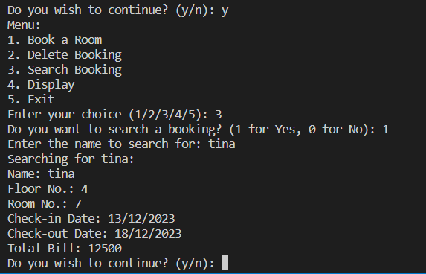
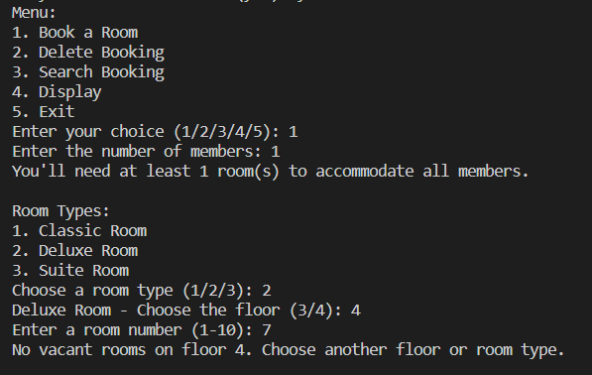
Searching for a booked room:
Showing no vacancy for an already booked room:

Slide 19



THANK YOU
Github repository link:
https://github.com/soumili-03/HOTEL-MANAGEMENT-SYSTEM

